Slide 1

Department of Computer Science
Banaras Hindu University
INTERVIEW SKILLS
Mahaveer
M.Sc Computer Science
Department of Computer Science
BHU, Varanasi (U.P)

Slide 2
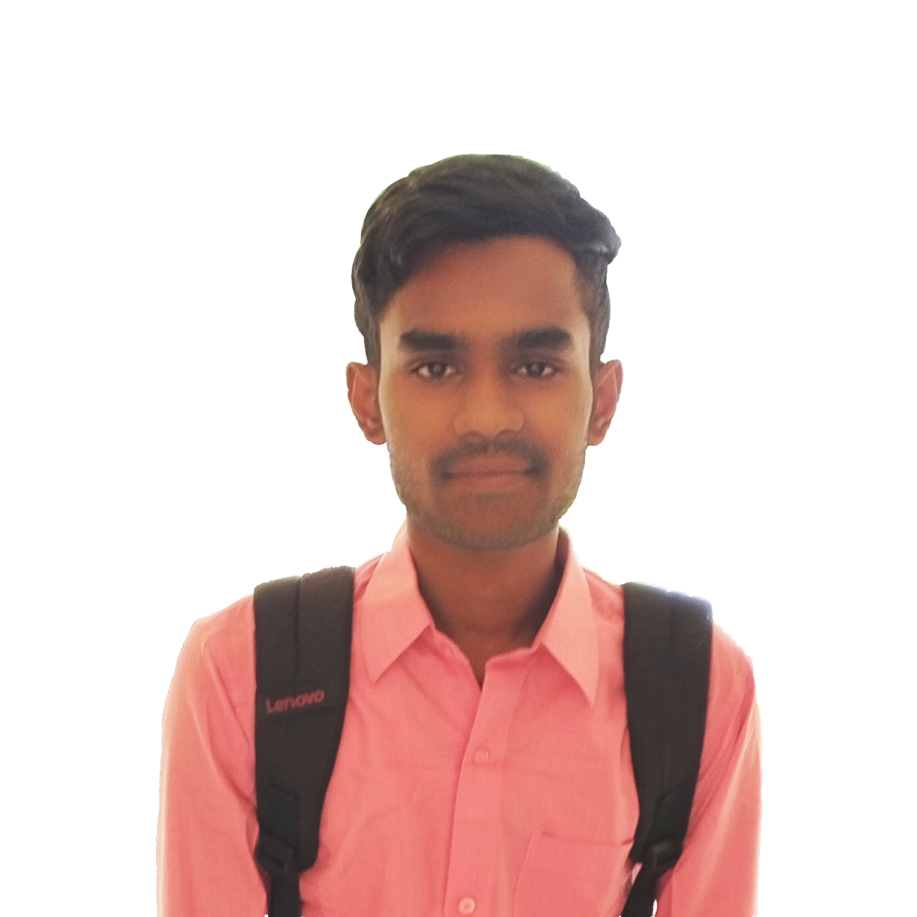
Department of Computer Science
Banaras Hindu University
Introduction
Mahaveer Suryavanshi
M.Sc Computer Science
Department of Computer Science
BHU, Varanasi (U.P)
B.Sc (Hon.) Computer Science
Department of Computer Science and Information Technologies
GGV, Bilaspur (Chhattisgarh)

Slide 3
Topics
Misconceptions About an interview
What is an interview
Preparation for an interview
Keys to success in interview
Attending an interview
Post interview Functions

Slide 4
Misconceptions About an interview
Possessing an impressive resume, ensure in the Interview
"I can get professional help in writing a resume, to get the best job in my area .."
My Good Looks will certainly get me the job...
"Looking good is important in the interview, but that is not the only selection criterion"
I have lots of talent, and certificates in sports and extracurricular activities ...
"Your talent will take there, you will still need skills to win in interviews"
I am the college topper, so I will top in all interviews..
"Many toppers get rejected due to lack of interview/communication skills !"

Slide 5
What is an interview ?
An interview is a question-and-answer session where one person asks questions, and the other person answers those questions.
Usually in an interview two parties are involved,
Interviewer (a person who interviews someone)
Interviewee (a person who is interviewed).

Slide 6
Preparation for an interview
Always Remember the three Ps
Plan - The first thing You Must do Before any Interview
Prepare - The Next Thing You Must Do Before Any Interview
Practices - The important thing you must do your interview
PURPOSE OF THE INTERVIEW
Employers are addressing
Your Personality
Communication Skills
Your Appearance
If you will fit into the organization
Your Strengths and weaknesses
Your Attitude
Verifying your resume

Slide 7
Keys to success in interview
The Basic qualifications that an employer is looking for are :
Skills - Knowledge & Proficiency in the field of study
Work Ethics - positive attitude toward work
Compatibility - is your personality match with others in the organization

Slide 8
Attending an interview
Structure of an Interview
Greeting, receiving & introduction
Casual, informal talk to develop rapport
Formal presentation of CV by self or panel
Clarifications on educational background, professional experience, etc
Motive for applying for the present job
Reason for leaving the previous job
Assessing suitability to the job
Acceptability to company's norms/conditions
Candidate's chance to ask questions
Thanks, bye and post interview operations

Slide 9
Attending an interview
How to Answer the questions
Listen to the question carefully
Think before you answer
Answer the question only
Don’ts
Don't expect easy presents
Don't promise what you can't offer
Don't accept what you don't need
Don't ask what they can't give you

Slide 10
Attending an interview
What people like
Modesty, not shyness
Enthusiasm & Energy, not over ambition...
Self-confidence, not arrogance
Assertiveness not aggressiveness
Short precise answer, not long, convoluted answer & meandering
What people don't Like
Wasting their time
Repetition
Over talking
Unclear explanations
Too many information
Aggressive approach
False Interest

Slide 11
Closing the interview
You want to achieve four objectives at the close of the interview :
Make it clear that you want the job
Set the stage for the next step
Create a final good impression
Get an actual offer

Slide 12
After Thoughts
“Each Interview is a learning experience”

Slide 13


